Slide 1
4.6-4.10

Slide 2
now
came
long
no
ask

Slide 3
now
came
long
no
ask

Slide 4
It is cold so now I will wear my coat.

Slide 5
This eraser is 4 inches long.

Slide 6
My grandparents came to my house.

Slide 7
“Do you play football?” “No! I do not play football.”

Slide 8
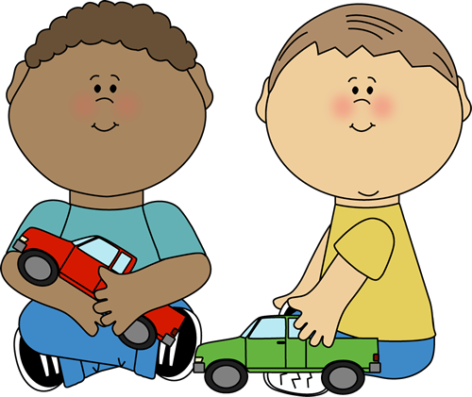
Let’s ask them to play with us!

Slide 9
came

Slide 10
no

Slide 11
now

Slide 12
long

Slide 13
ask

Slide 14
no

Slide 15
came

Slide 16
now

Slide 17
no

Slide 18
long

Slide 19
came

Slide 20
ask

Slide 21
long

Slide 22
now

Slide 23
came

Slide 24
ask

